Slide 1

Sentiment Analyses
Bidisha Paul
MCS-DS
University of Illinois at Urbana Champaign

Slide 2

Objective
The project’s goal is to develop a model using sentiments from amazon reviews for electronic products. The objective is find out which Amazon product has lower reviews and which ones are the highly rated products. The dataset contains 30000 samples containing details such as product name, id, reviews.dorecommend, reviews.text, rating

Slide 3
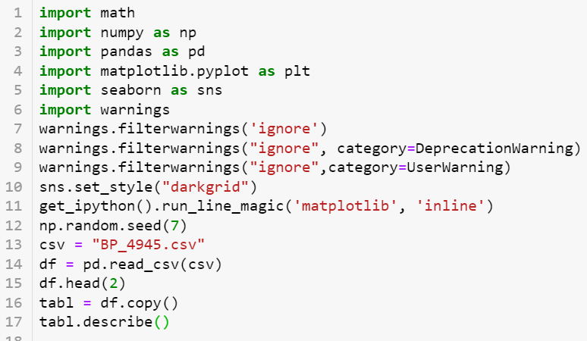
Code

Slide 4
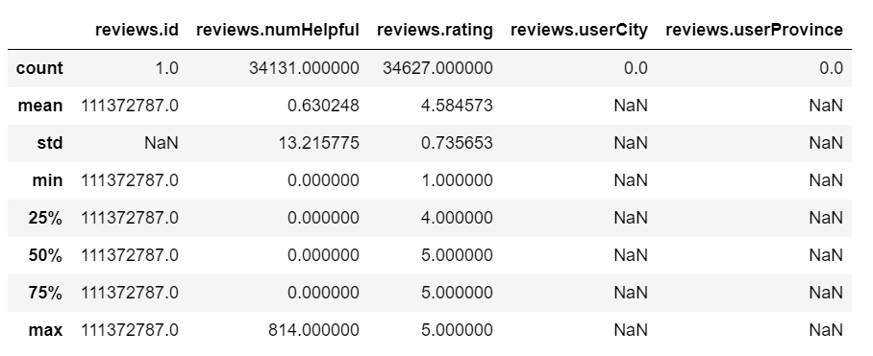
Descriptive Statistics
Amazon reviews on product

Slide 5
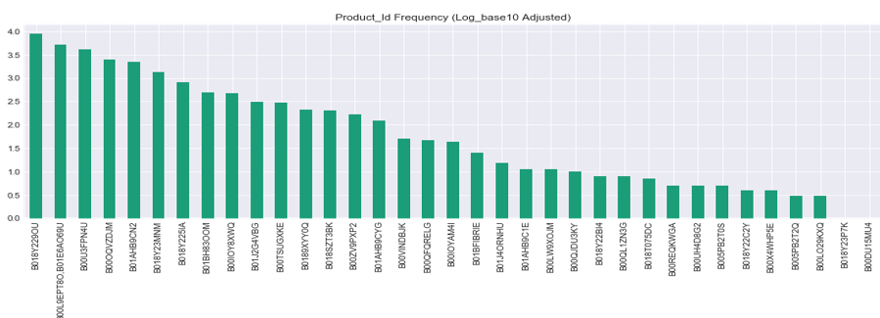
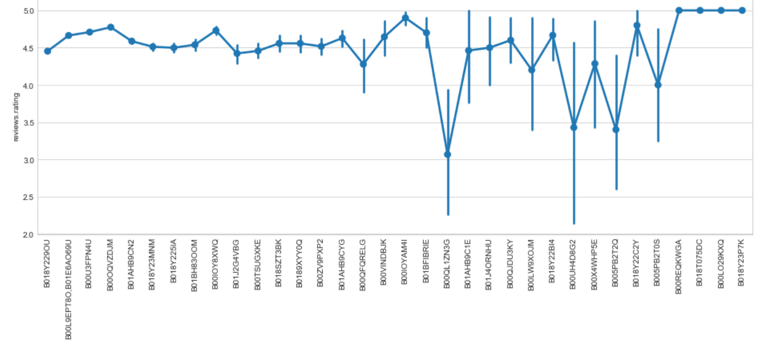

Slide 6
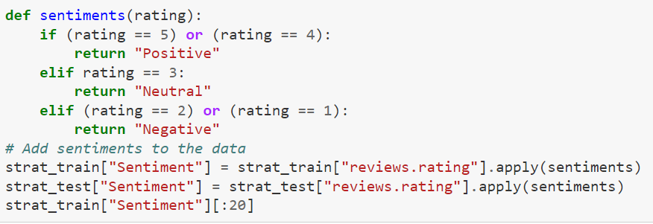
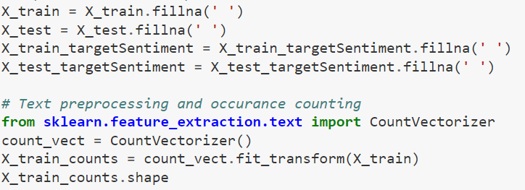
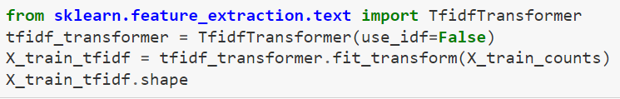
Sentiment Analyses and Bag of Words

Slide 7
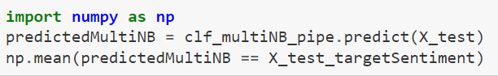
Tfidf Transformer
Building a pipeline using Multinomial Naïve Baiyes
0.9344498989315623

Slide 8
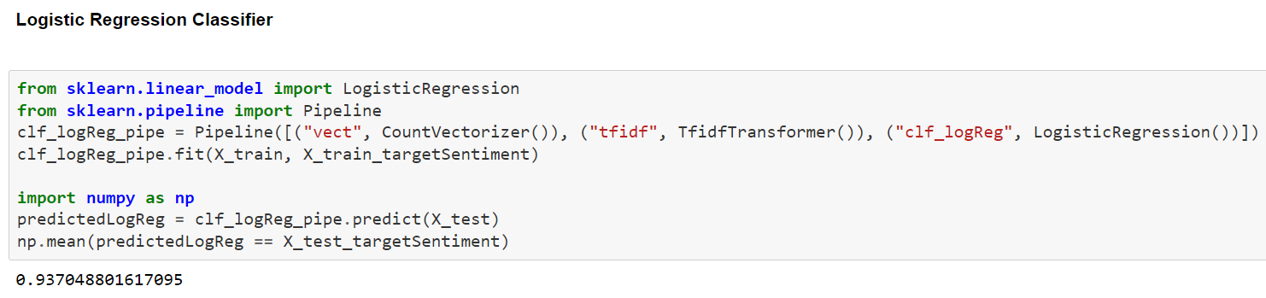
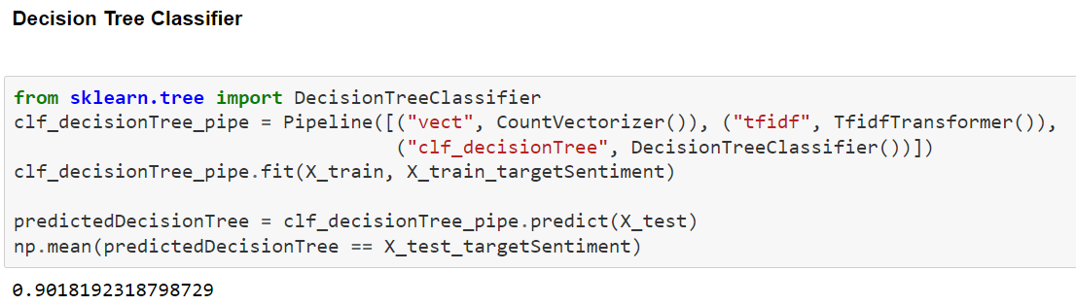
Testing Other Models

Slide 9
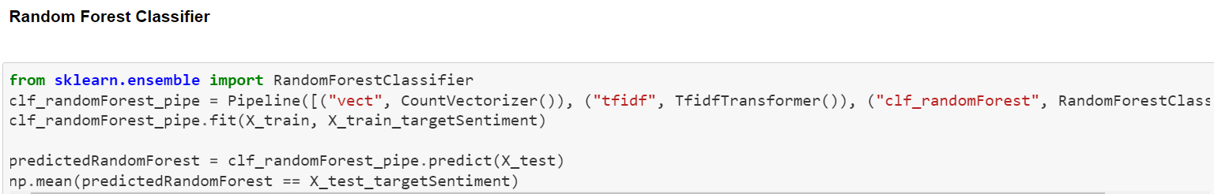
Testing Other Models
0.9345942824140918

Slide 10
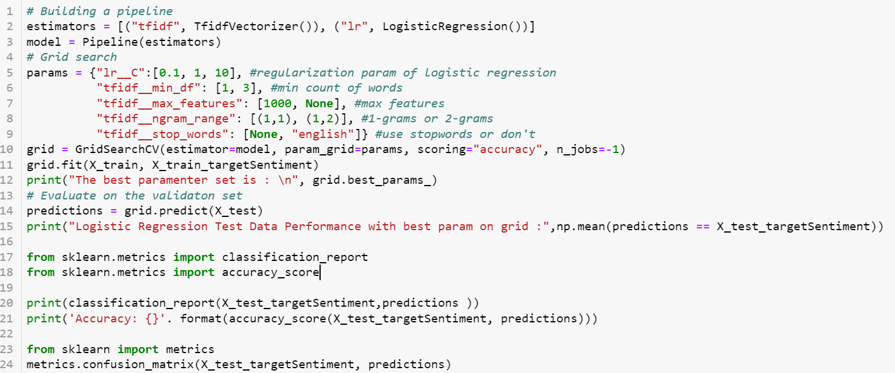
Fine Tuning the Classifier

Slide 11
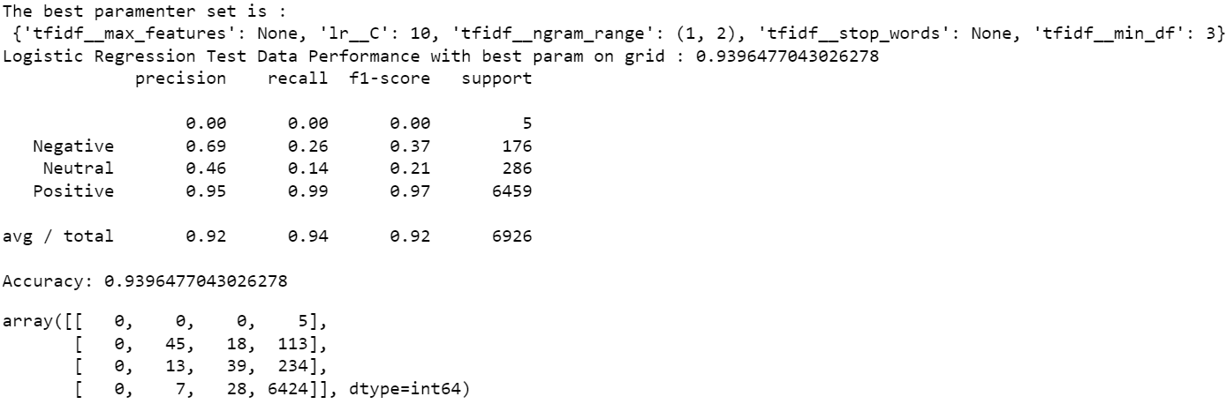
Result

Slide 12
Conclusion
Logistic Regression with hyperparameter optimization gave the best result indicating that a simple regression model can perform better depending on the data.

Slide 13
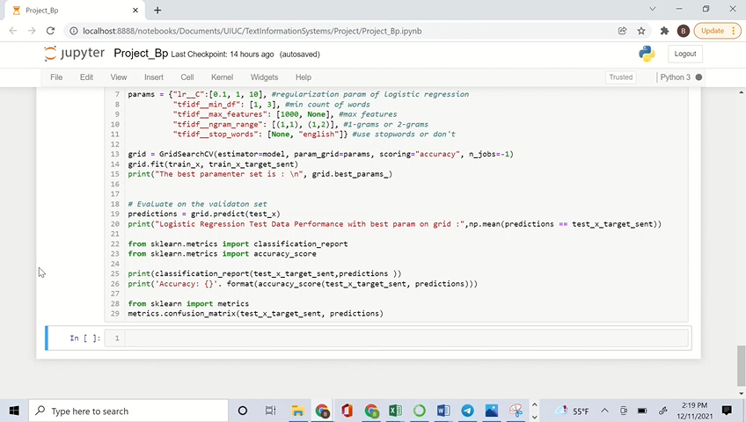
Live Code Video

